Slide 1
Neuromorphic technologies
Philip Dumaresq

Slide 2
What does that even mean?
Neuromorphic technology is a fancy word for computer chips that mimic the structure of the human brain.
The human brain is made up of billions of little receptors and transmitters called neurons that fire electrical signals through the brain. These are called synapses.
It’s the firing of synapses in your brain that help you recognize the world around you, through your memory.

Slide 3
Okay, so what?
So the way that humans understand the world around them is by specific sequences of synapses firing in the brain.
Any nerves on your body that have input will send that input to your brain, which will understand the stimulation through its memory.
By mimicking this course of events in a computer chip, we can build processors that better understand the world around them
We can build better hardware for image processing software, voice recognition software, or software that can react to feeling through synthetic nerves.

Slide 4
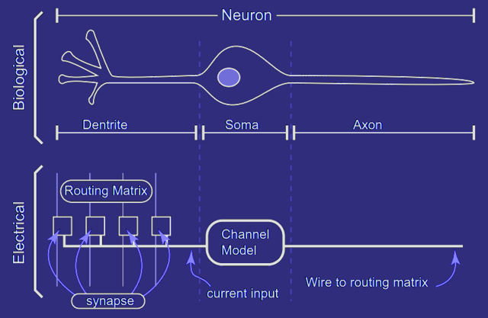

Slide 5
Okay, who came up with this stuff?
Neuromorphic chips were first conceptualized in the late 1980’s by an American scientist named Carver Mead.
Mead was a professor and researcher at the California institute of technology (CalTech)
Being a semiconductor engineer, he began looking into ways to improve modern computer chips, looking at the most efficient “computer” he knew – the human brain.

Slide 6
That was the 80’s, where are we now?
Today, Qualcomm and NVidia are the biggest producers of neuromorphic processors in the world, slowly trying to integrate them into modern smartphones for use in software like Siri or Cortana for voice recognition, or Snapchat filters for image processing.
Neuromorphic chips are worlds better than traditional processors for recognizing the world around them and real world patterns, images and sound.
Neuromorphic chips are being used for research in AI, to build a system that thinks like a human.

Slide 7
…How is that controversial?
There’s a couple primary reasons for controversy over these computer chips. the first reason being the far most relevant one today; it’s all a question of personal privacy and security.

Slide 8
How these chips affect your privacy
Our world is covered in security cameras. Lets be realistic, were almost always being watched. And if we’re not, we have the potential to be.
Everything around us has a camera in it these days, our phones, our laptops, the computers in our labs, the hallways at school, the intersections we pass through, outside buildings in the city, they’re everywhere.
Now imagine all those cameras were backed by software that could recognize who you are.

Slide 9
So What does this change compared to traditional methods?
In traditional security cameras, the footage is only ever going to be checked is something happens, so that police can know what happened. A human will need to watch the footage.
In a regular camera, the footage will only be watched if something happens. In these cameras, they’ll be rolling an observing nonstop.
Now, a computer can tell all that. A computer can look at you, know who you are, what you’re doing, and track you, follow you. You carry a GPS around in your pocket every day, you’re already being tracked, but this is far more precise.
It’s not just your location getting tracked, it’s you. Your actions, your habits, your tendencies and behavior.

Slide 10
Privacy vs security
It all comes down to the question of giving up your privacy for more security. Are we really willing to give up any privacy that we have left?
Big companies like Facebook and Google are already tracking everything we do on the internet to use us as their product for targeted advertising, but now we’re getting tracked in real life too.
Will adds be targeted to us in the real world now too? Will we start seeing promotions for stores we visit in real life, or for things that we buy in cash?

Slide 11
Another issue – A little bit more theoretical

Slide 12
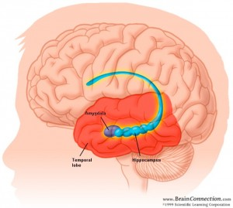

Slide 13
What am I getting at?
Imagine being able to do a scan of someone’s brain to build a mapping of all the neurons, just in their hippocampus, then modelling a chip’s architecture off of that specific brain.
I explained earlier what synapses are, just electrical signals getting fired across different neurons in your brain.
A memory is just a specific sequence of synapses firing. It’s something very physical, and something that can get triggered.
If you could record the sequences of synapses somehow, in theory you could recreate a memory inside a computer chip.

Slide 14
Imagine the consequences
If your memories could exist on a hard drive, then your mind could live on beyond the lifespan of your body. Could your consciousness live on forever, even if your body won’t?
If you can recreate your memories on a computer, can memories in a computer be recreated in your mind as well? Could you download a sequence off the internet and download information to get stored directly into your long term memory?
This is something that Elon Musk has talked about – merging human and machine intelligence. Musk believes that in a future world of AI, it’s the only way that humans will remain relevant. But do we really want to get to the point where we will need to ‘merge’ with technology just to live our lives?

Slide 15
So how do we stop this?
Technology evolves way faster than our laws do. Our laws are constantly struggling to keep up with new technologies, law enforcement has no idea how to handle drones for example.
We need more lawyers and law makers who specialize in dealing with technology. People who can adapt existing laws to their understanding of new and emerging technologies.
I think that we need to take a more proactive approach to law making and regulation. Normally, laws are put in place to keep technology in check once it’s been made available, but I think that needs to change.

Slide 16
Experts in various fields need to be consulted, and law makers need to get an idea of where technology is progressing to so that they can take measures before they fall behind.
Things need to be regulated, and the amount that companies or our government can spy on us is one of them, even if that’s hardly regulated right now.
Today, there are so many laws in place that allow the US government to violate your privacy. Any information you have stored on US based servers, is accessible to the government. And with neuromorphic chips, there will be a huge influx of data available about you.

Slide 17
What we can do?
We all need to be more aware of new technologies that are coming out and will soon be surrounding our world.
For technologies that are a threat to us, in any way: if they threaten our privacy, our property, our livelihood; we need to speak up.
Online petitions do a lot more than we might think that they do – they bring influence the decision makers by showing them the public opinion, They let the media know that the issue has enough to write about it, and they can bring money to a cause.
Don’t get me wrong, I think that neuromorphic chips are amazing and should be integrated into our lives – but not as a method to spy on us.

Slide 18
Reference
http://www.33rdsquare.com/2014/04/a-roadmap-to-neuromorphic-systems.html
http://billmoyers.com/story/sign-save-world-online-petitions-explained/
http://www.mayfieldclinic.com/PE-AnatBrain.htm
http://www.33rdsquare.com/2014/04/a-roadmap-to-neuromorphic-systems.html
http://web.stanford.edu/group/brainsinsilicon/documents/JArthur_dissertation.pdf
https://web.stanford.edu/group/brainsinsilicon/about.html
https://www.theguardian.com/technology/2014/may/04/facial-recognition-technology-identity-tesco-ethical-issues

